Slide 1


Keras NLP: Sentiment Analysis
DJS InfoMatrix ML Domain - Pranav

Slide 2
Hi!
How are Yall?
Do you guys remember what we did last time?

Slide 3

01
Introduction
KerasNLP is a natural language processing library.
It’s workflows are built from modular components that have state-of-the-art preset weights and architectures.
Easily customizable when more control is needed.

Slide 4
Today’s content
01
02
03
04
05
06
Inference with a pre trained classifier
Fine tuning a pre trained backbone
Fine tuning with user-controlled preprocessing
Fine tuning a custom model
Pretraining a backbone model
Build and train your own transformer from scratch

Slide 5
What are different components in NLP?
Tokenizer: keras_nlp.models.XXTokenizer Converts strings to sequences of token ids.
Preprocessor: keras_nlp.models.XXPreprocessor Converts strings to a dictionary of preprocessed tensors consumed by the backbone, starting with tokenization.
Backbone: keras_nlp.models.XXBackbone Converts preprocessed tensors to dense features. Does not handle strings; call the preprocessor first.
Task: e.g., keras_nlp.models.XXClassifier Converts strings to task-specific output (e.g., classification probabilities).

Slide 6
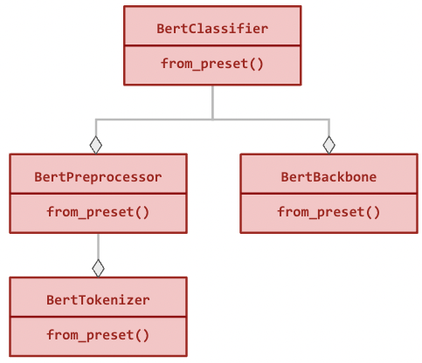
Hierarchy

Slide 7
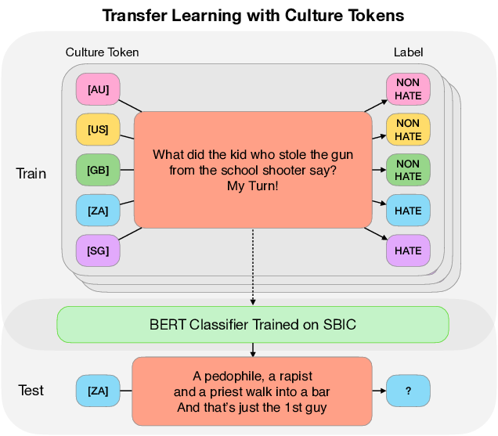
An Example

Slide 8
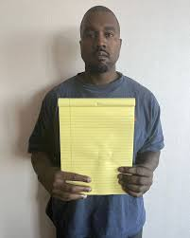
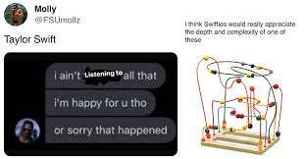
Abhi-Rizz
break
Vihaan ovaryleker

Slide 9
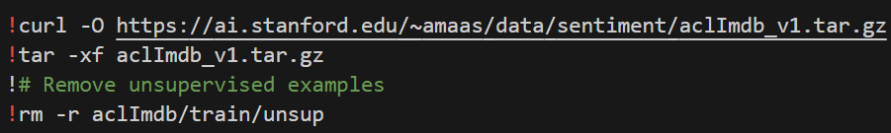
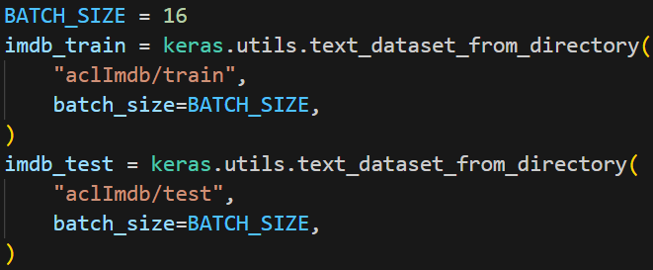
Data
Dataset
We will sentiment analysis of IMDB movie reviews. We use the text to predict whether the review was positive (label = 1) or negative (label = 0).

Slide 10
2. Inference with a pretrained classifier
BertClassifier
Predict
BERT utilizes transfer learning to understand the context of text data.
Your Task

Slide 11
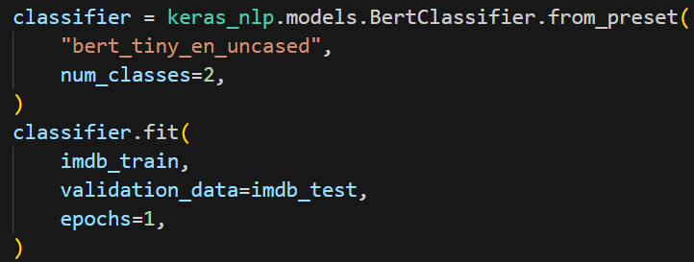
3. Fine tuning a pretrained BERT backbone
What have we done?
Why 2 classes?
?????? (Rishabh)
?????? (Abhijeet)

Slide 12
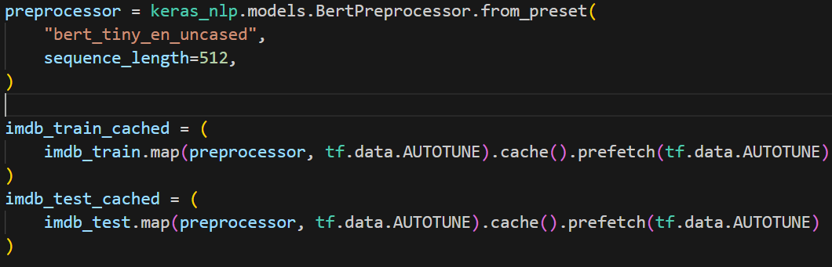
4. Fine tuning with user-controlled preprocessing
BertPreprocessor
Mapping & AUTOTUNE
A BERT preprocessing layer which tokenizes and packs inputs.
Prompt the tf. data runtime to tune the value dynamically at runtime.

Slide 13
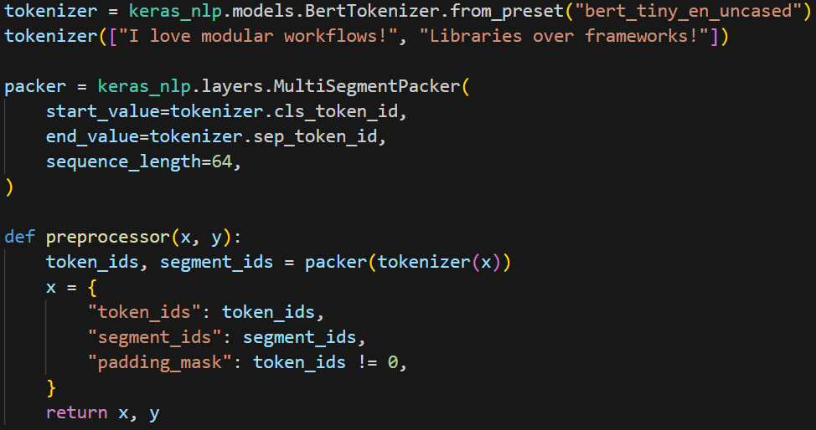
Differences
5. Custom preprocessing
Tokenizer
Tokenizer always requires custom padding
Packs multiple sequences into a single fixed width model input. This layer packs multiple input sequences into a single fixed width sequence containing start and end delimeters, forming a dense input suitable for a classification task for BERT and BERT-like models.

Slide 14

0
Rizz-Shabh Break
= Number of bitches you pull after doing NLP

Slide 15
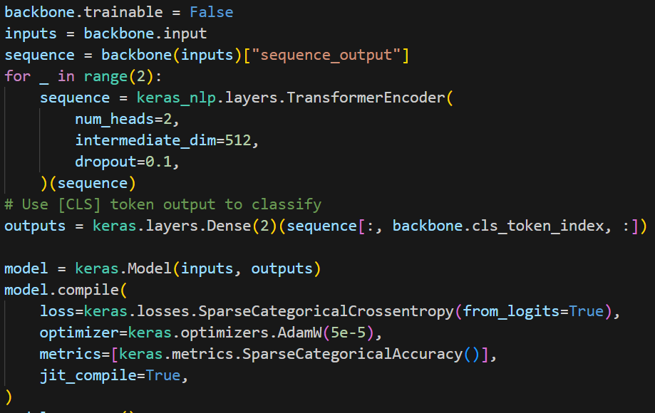
6. Fine tuning with a custom model

Slide 16
Transformer Encoder
intermediate_dim
num_heads
This layer will correctly compute an attention mask from an implicit Keras padding mask.
int, the hidden size of feedforward network.
int, the number of heads in the keras.layers.MultiHeadAttention layer.

Slide 17
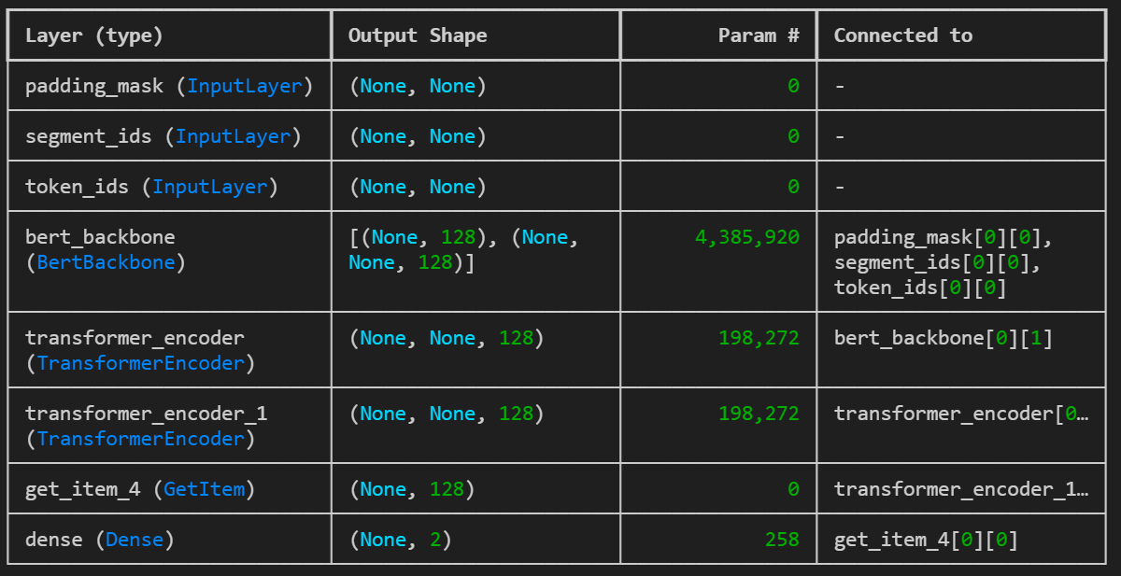
Model Summary + Task

Slide 18
Abhi-Rizz
break
Vihaan ovaryleker

Slide 19
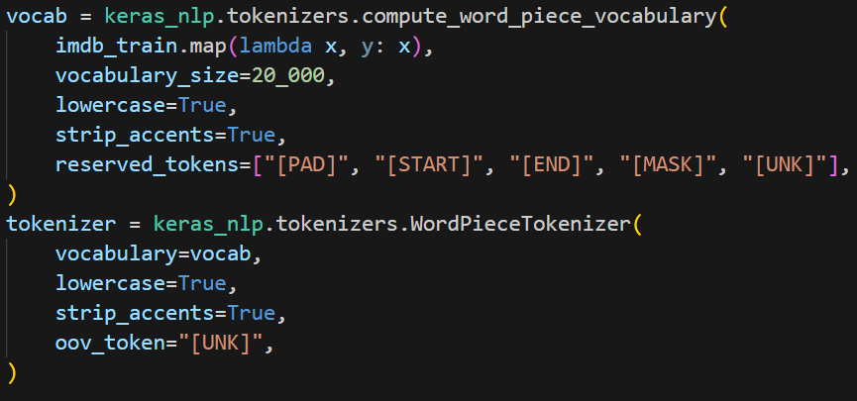
Train custom vocabulary from IMDB data

Slide 20
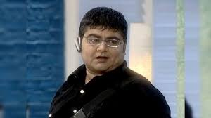
I’ll Explain
2 Step Procedure where we first compute the tokenizer and then go forward and initialize it.

Slide 21
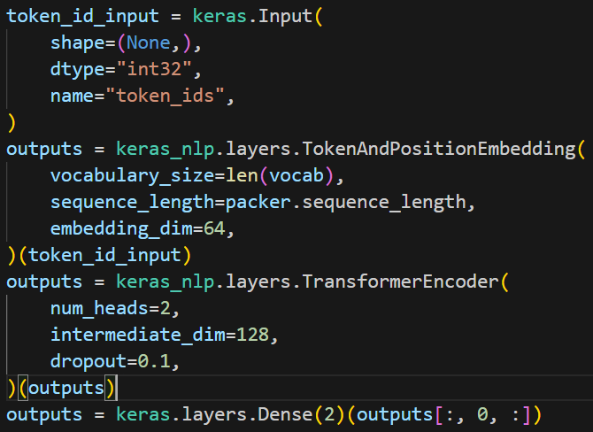
7. Design a tiny Transformer

Slide 22
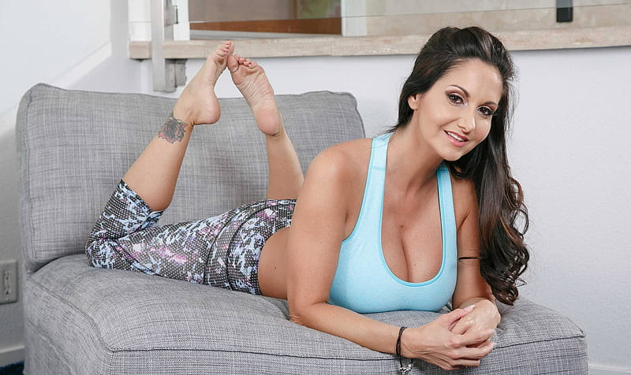
Thank You!

